Slide 1
Introducing Reinforcement learning
Scott O’Hara
Metrowest Developers Machine Learning Group

Slide 2
References
University of California, Berkeley CS188:
CS188 – Introduction to Artificial Intelligence, Profs. Dan Klein, Pieter Abbeel, et al. http://ai.berkeley.edu/home.html
David Silver, DeepMind:
Introduction to Reinforcement Learning http://www0.cs.ucl.ac.uk/staff/d.silver/web/Teaching.html
CS181 course at Harvard University:
CS181 Intelligent Machines: Perception, Learning and Uncertainty, Sarah Finney, Spring 2009
CS181 Intelligent Machines: Perception, Learning and Uncertainty, Prof. David C Brooks, Spring 2011
CS181 – Machine Learning, Prof. Ryan P. Adams, Spring 2014. https://github.com/wihl/cs181-spring2014
CS181 – Machine Learning, Prof. David Parkes, Spring 2017. https://harvard-ml-courses.github.io/cs181-web-2017/
The material for these talks are primarily drawn from the slides, notes and lectures of these courses:

Slide 3
UC Berkeley CS188 is a great resource
http://ai.berkeley.edu/home.html
Covers:
Search
Constraint Satisfaction
Games
Reinforcement Learning
Bayesian Networks
Surveys Advanced Topics
And more…
Contains: accessible, high quality YouTube videos, PowerPoint slides and homework.
Series of projects based on the video game PacMan.
Material is used in many courses around the country.

Slide 4
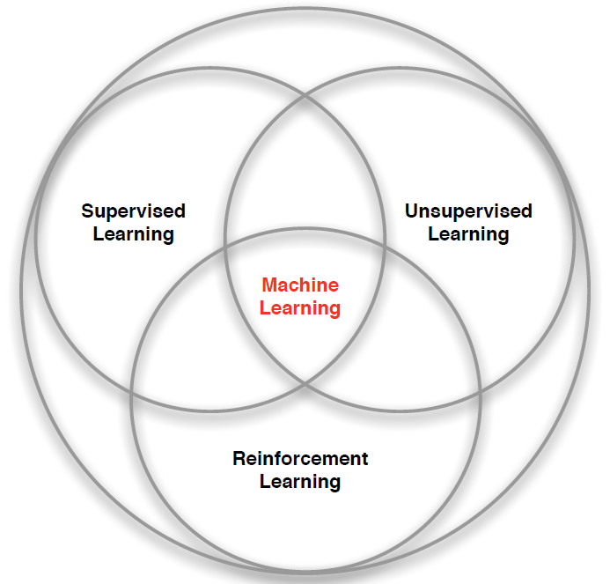
Types of Machine Learning
Credit: adapted from lecture slides David Silver, DeepMind, “Introduction to Reinforcement Learning

Slide 5

Types of Machine Learning
There are (at least) 3 broad categories of machine learning problems:
Supervised Learning
$Data=\left\{\left(x_{1},y_{1}\right),…,\left(x_{n},y_{n}\right)\right\}$
e.g., linear regression, decision trees, SVMs
Unsupervised Learning
$Data=\left\{x_{1},,…,x_{n}\right\}$
e.g., K-means, HAC, Gaussian mixture models
Reinforcement Learning
$Data=\left\{s_{1},a_{1},r_{1},s_{2},a_{2},r_{2}… \right\}$
an agent learns to act in an uncertain environment by training on data that are sequences of state, action, reward.

Slide 6
Reinforcement Learning: the basic idea
Select an action.
If action leads to reward, reinforce that action.
If action leads to punishment, avoid that action.
Basically, a computational form of Behaviorism (Pavlov, B. F. Skinner).

Slide 7
Characteristics of Reinforcement Learning
Learning happens as the agent interact with the world.
Unlike supervised learning, there are no training or test sets. Training is guided by rewards and punishments.
The amount of “training data” an agent receives is not fixed. More information is acquired as you go.
Actions are not always rewarded or punished immediately. “Delayed gratification” is possible.
Agent actions can affect the subsequent data it receives. E.g., closing a door that can’t be opened again.

Slide 8
Reinforcement Learning Example: Playing Atari breakout
Google DeepMind's Deep Q-Learning & Superhuman Atari Gameplays
https://youtu.be/Ih8EfvOzBOY
3 mins 45 secs
Credit: Two Minute Papers - Károly Zsolnai-Fehér
Notes:
Convert to a video.

Slide 9
Reinforcement Learning Example: Terrain traversal
Terrain Traversal with Reinforcement Learning
https://youtu.be/_yjHPu1aYCY
2 mins 38 secs
Credit: Two Minute Papers #26- Károly Zsolnai-Fehér
Notes:
Convert to a video.

Slide 10
Reinforcement Learning Examples:
Fly stunt maneuvers in a helicopter
Defeat the world champion at Backgammon
Manage an investment portfolio
Control a power station
Make a humanoid robot walk
Play Atari games better than humans
https://youtu.be/2pWv7GOvuf0?t=940
(15:40 – 22.00 [6 mins 20 secs)
Credit: David Silver, DeepMind, “Introduction to Reinforcement Learning
Notes:
Review this list and make it consistent with the video.

Slide 11
MARKOV DECISION PROCESSES
The Markov Decision Process (MDP) provides a mathematical framework for reinforcement learning.
An MDP is used to model optimal decision-making in situations where outcomes are uncertain.
<https://en.wikipedia.org/w/index.php?title=Markov_decision_process&oldid=855934986> [accessed 11 September 2018]

Slide 12
The decision framework for MDPs
Modeling Uncertainty
Use probability to model uncertainty about the domain.
Modeling an Agent’s Objectives
Use utility to model an agent’s objectives.
Decision Policy
The goal is to design a decision policy, describing how the agent should act in all possible states in order to maximize its expected utility.

Slide 13
Uncertainty is modeled with Probability
The agent may not know the current state of the world
The effects of the agent’s action might be unpredictable.
Things happen that are outside the agent’s control.
The agent may be uncertain about the correct model of the world.

Slide 14
Goals (“Happiness”) modeled with utility
Utility is a real number.
The higher the utility, the “happier” your robot is.
Utility is based on the assumptions of Utility Theory, which if obeyed, make you rational.
For example, if you prefer reward A to reward B, and you prefer reward B to reward C, then you should prefer reward A to reward C.

Slide 15
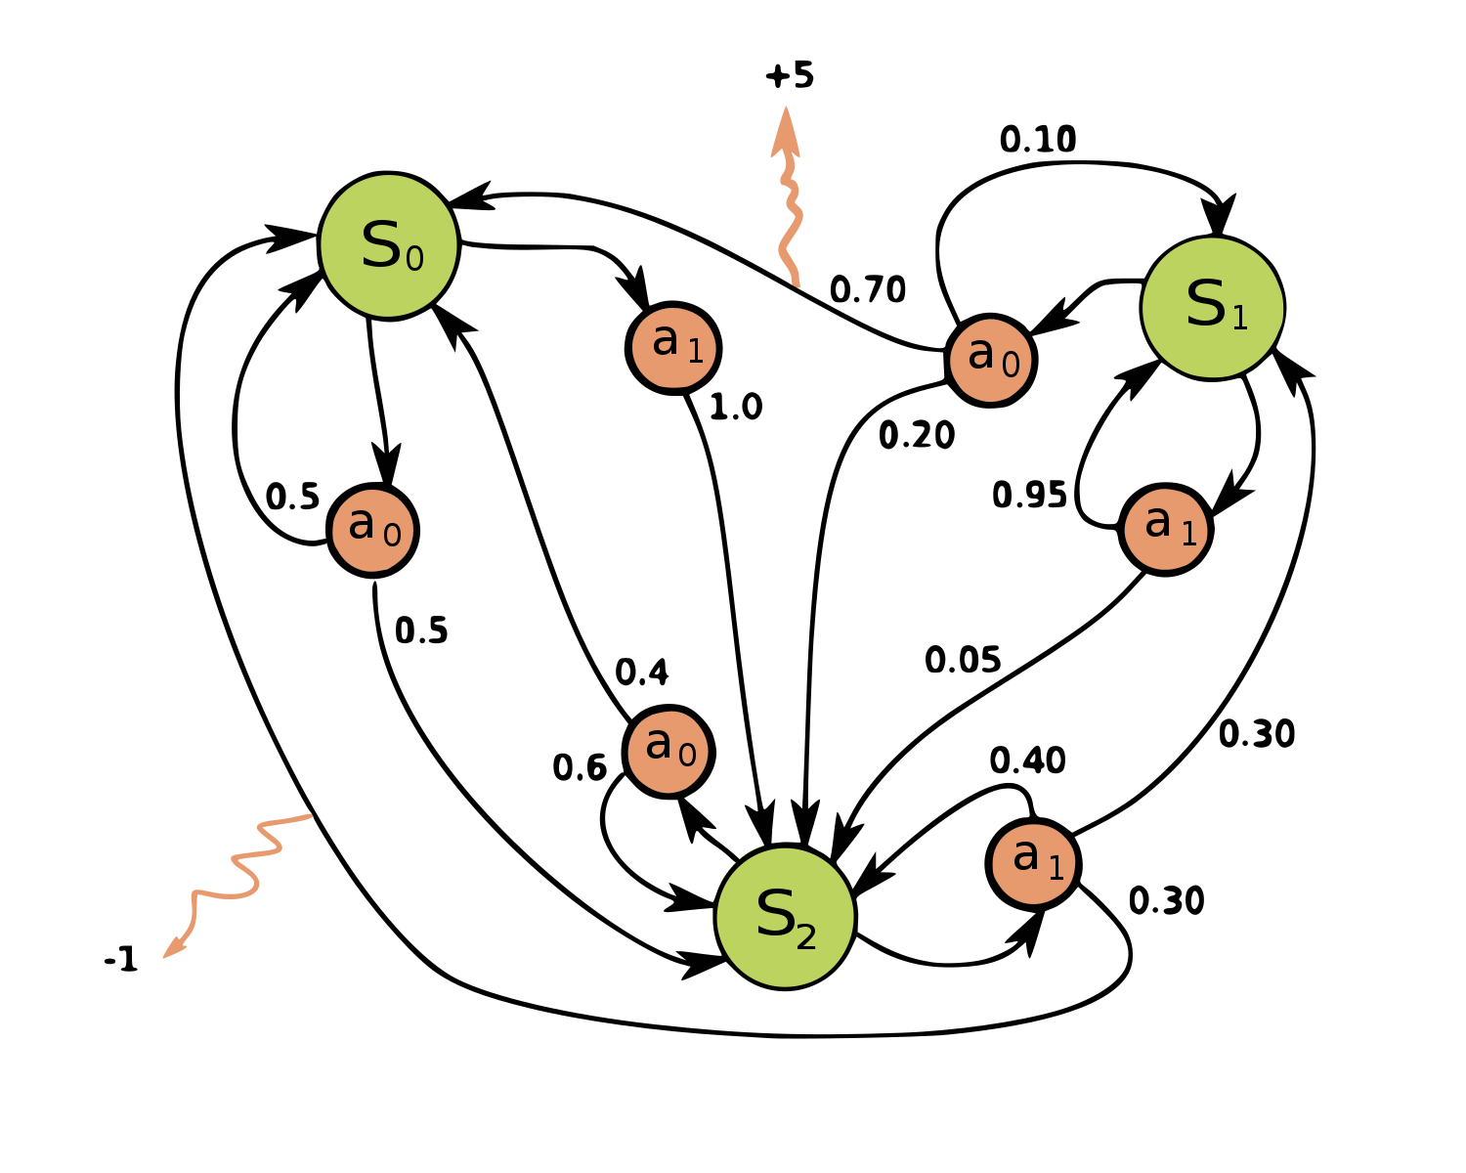
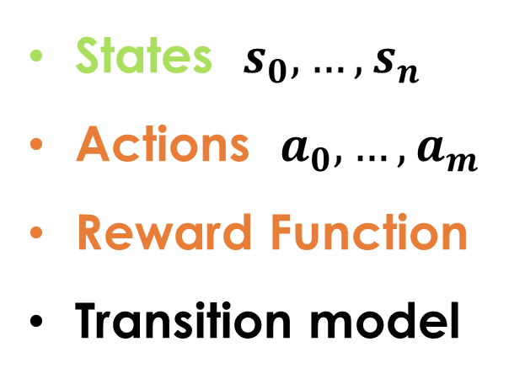
Markov decision processes
States: $s_{0},…,s_{n}$
Actions: $a_{0},…,a_{m}$
Reward Function:
Transition model:
<https://en.wikipedia.org/w/index.php?title=Markov_decision_process&oldid=855934986> [accessed 11 September 2018]

Slide 16
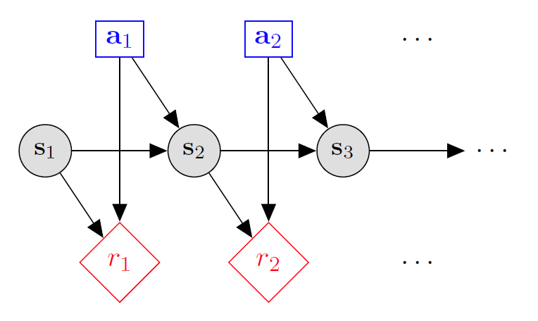

MDP Goal: find an optimal policy π
GOAL: find a policy π that tells you what action to take in each state. We want to find ‘rewarding’ policies.
n state policy:
$$π\left(s_{1}\right)= a_{1}$$
$$π\left(s_{2}\right)= a_{2}$$
$$π\left(s_{3}\right)= a_{3}$$
…
$$π\left(s_{n}\right)= a_{n}$$

Slide 17
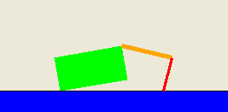
Application: Crawler robot
Arm 1
Arm 2
States: <location, arm 1 angle, arm 2 angle>
Actions:
Reward Function: +1 if robot moves right, -1 if robot moves left
Transition model: model of box movement caused by arm movements.

Slide 18
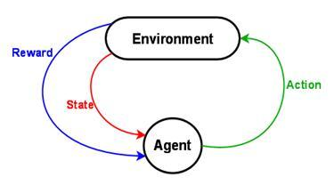
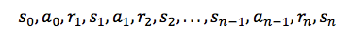
The Reinforcement Learning Problem
<https://www.intel.ai/demystifying-deep-reinforcement-learning> [accessed 29 January 2020]

Slide 19
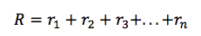
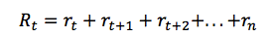
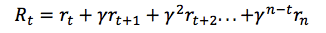
Discounted Reward
Total Future Reward:
Total Reward for One Episode:
Total Discounted Future Reward (γ is the discount factor between 0 and 1)
<https://www.intel.ai/demystifying-deep-reinforcement-learning> [accessed 29 January 2020]

Slide 20
Discounted Reward
If we set the discount factor γ=0, then our strategy will be short-sighted and relies only on immediate rewards.
If we want to balance between immediate and future rewards, we should set discount factor to something like γ=0.9.
If our environment is deterministic and the same actions always result in same rewards, then we can set discount factor γ=1.
A good strategy for an agent would be to always choose an action that maximizes the (discounted) future reward.
<https://www.intel.ai/demystifying-deep-reinforcement-learning> [accessed 29 January 2020]

Slide 21
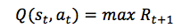
Q-Learning
In Q-learning we define a function Q(s, a) representing the maximum discounted future reward when we perform action a in state s, and continue optimally from that point on.
The way to think about Q(s, a) is that it is “the best possible score at the end of the game after performing action a in state s“.
It is called Q-function, because it represents the “quality” of a certain action in a given state.
<https://www.intel.ai/demystifying-deep-reinforcement-learning> [accessed 29 January 2020]

Slide 22
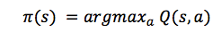
Q(s,a) gives the Optimal Policy
Suppose you are in state and pondering whether you should take action a or b. You want to select the action that results in the highest score at the end of game.
Once you have the magical Q-function, the answer becomes really simple – pick the action with the highest Q-value!
Here π represents the policy, the rule how we choose an action in each state.
<https://www.intel.ai/demystifying-deep-reinforcement-learning> [accessed 29 January 2020]

Slide 23
The bellman Equation
The main idea in Q-learning is that we can iteratively approximate the Q-function using the Bellman equation.
With the Bellman Equation, we express the Q-value of state s and action a in terms of the Q-value of the next state s’.
The maximum future reward for state s and action a is the immediate reward plus maximum future reward for the next state s’.
<https://www.intel.ai/demystifying-deep-reinforcement-learning> [accessed 29 January 2020]

Slide 24
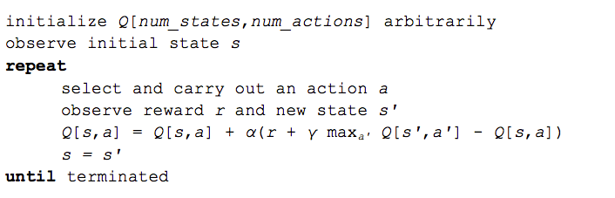
The Q-Learning Algorithm
α in the algorithm is a learning rate that controls how much of the difference between previous Q-value and newly proposed Q-value is taken into account.
<https://www.intel.ai/demystifying-deep-reinforcement-learning> [accessed 29 January 2020]

Slide 25
Rewriting The Q(s,a) update
$$Q\left[s,a\right]←Q\left[s,a\right]+α(r+γ\max_{a^{′}}{Q_{k}\left[s^{′},a^{′}\right]}−Q\left[s,a\right])$$
Can be rewritten as:
$$Q\left[s,a\right]←\left(1−α\right)Q\left[s,a\right]+α(r+\underset{a^{′}}{γmax}{Q_{k}\left[s^{′},a^{′}\right]})$$
<https://www.intel.ai/demystifying-deep-reinforcement-learning> [accessed 29 January 2020]

Slide 26
The Q-Learning Algorithm Converges on the True q-value
The max_{a’} Q[s’,a’] that we use to update Q[s,a] is only an approximation and in early stages of learning it may be completely wrong.
However the approximation get more and more accurate with every iteration and it has been shown, that if we perform this update enough times, then the Q-function will converge and represent the true Q-value.
<https://www.intel.ai/demystifying-deep-reinforcement-learning> [accessed 29 January 2020]

Slide 27
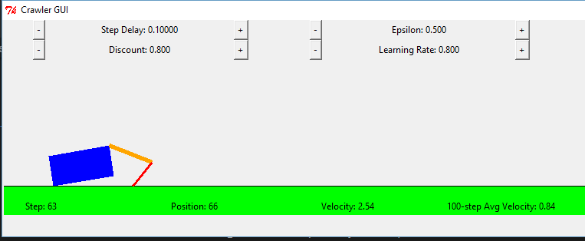
Q-Learning Example: Crawler Robot
Credit: CS188 – Intro to AI, UC Berkeley, ai.berkely.edu

Slide 28
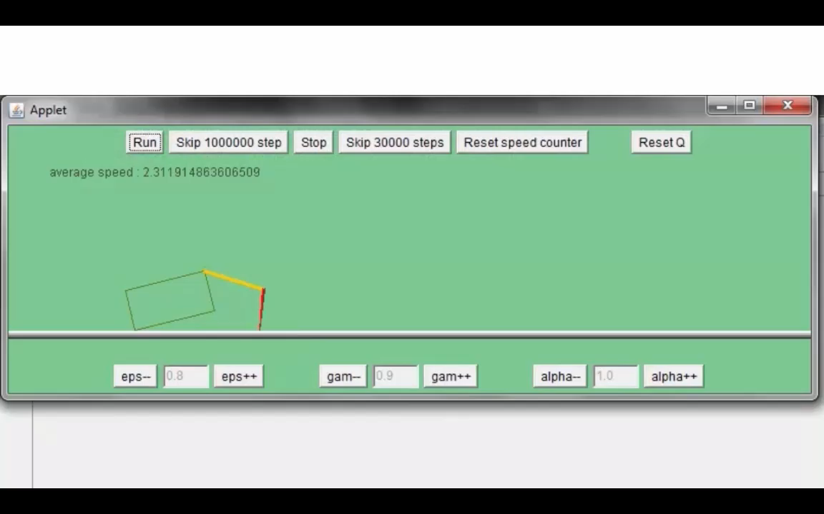
Video 1 of Q-Learning demo -- Crawler
Credit: CS188 – Intro to AI, UC Berkeley, ai.berkely.edu

Slide 29
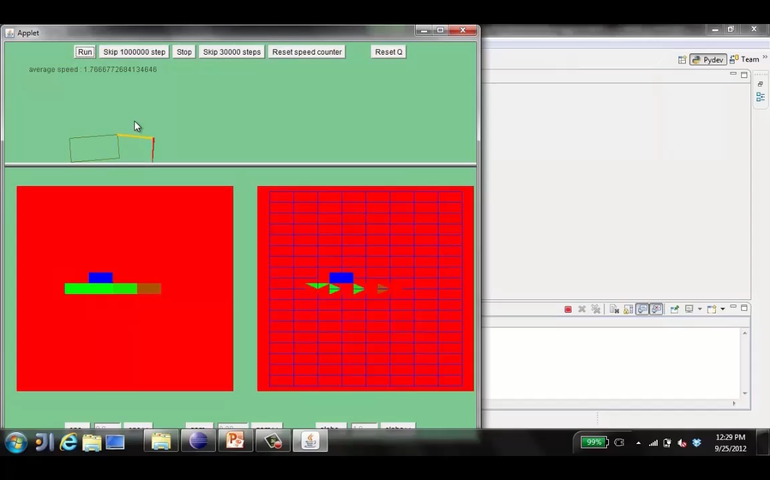
Video 2 of Q-Learning demo -- Crawler
Credit: CS188 – Intro to AI, UC Berkeley, ai.berkely.edu

Slide 30
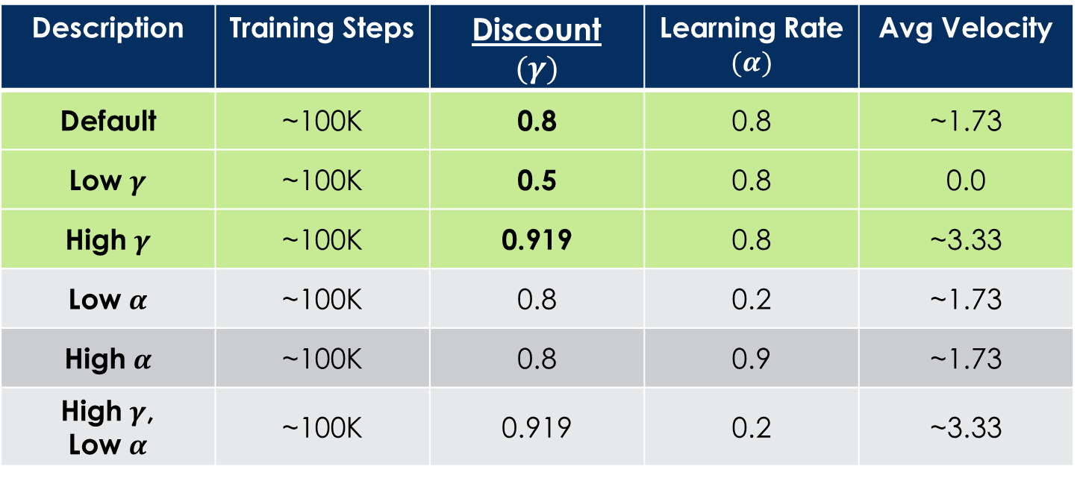
Q-Learning Example: discount effect
Update rule:
Description | Training Steps | Discount $$(γ)$$ | Learning Rate $$(α)$$ | Avg Velocity
Default | ~100K | 0.8 | 0.8 | ~1.73
Low $γ$ | ~100K | 0.5 | 0.8 | 0.0
High $γ$ | ~100K | 0.919 | 0.8 | ~3.33
Low $α$ | ~100K | 0.8 | 0.2 | ~1.73
High $α$ | ~100K | 0.8 | 0.9 | ~1.73
High $γ$, Low $α$ | ~100K | 0.919 | 0.2 | ~3.33

Slide 31
Introducing Reinforcement learning
Scott O’Hara
Metrowest Developers Machine Learning Group

Slide 32





Application: Grid World
A maze-like problem
The agent lives in a grid
Walls block the agent’s path
Noisy movement: actions do not always go as planned
80% of the time, the action North takes the agent North (if there is no wall there)
10% of the time, North takes the agent West; 10% East
If there is a wall in the direction the agent would have been taken, the agent stays put
The agent receives rewards each time step
Small “living” reward each step (can be negative)
Big rewards come at the end (good or bad)
Goal: maximize sum of rewards
Notes:
[cut demo of moving around in grid world program]

Slide 33
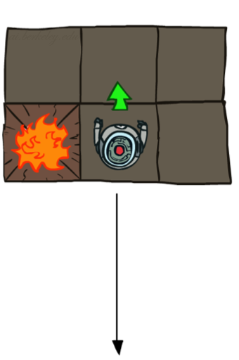
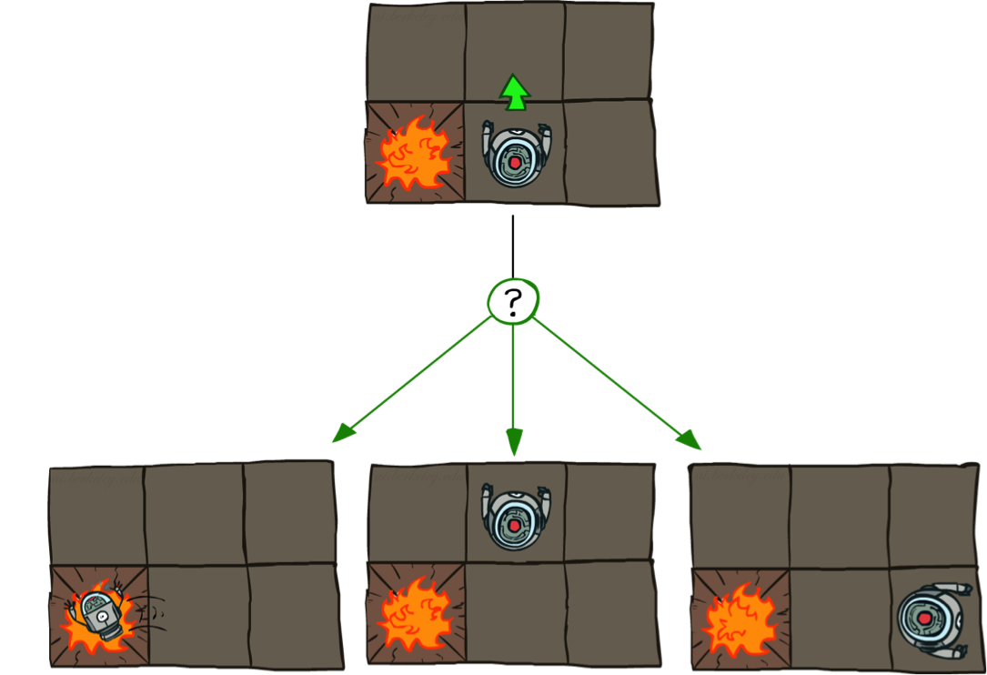

Grid World Actions
Deterministic Grid World
Stochastic Grid World

Slide 34
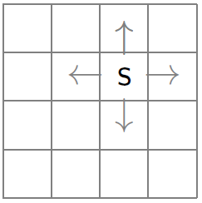
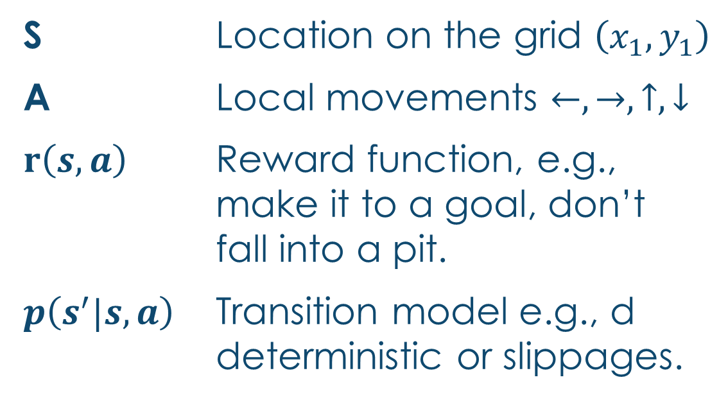
The gridworld Markov Decision Process
S Location on the grid $\left(x_{1},y_{1}\right)$
A Local movements $←,→,↑,↓$
$r\left(s,a\right)$ Reward function, e.g., make it to a goal, don’t fall into a pit.
$p\left(s^{′}|s,a\right)$ Transition model e.g., d deterministic or slippages.

Slide 35
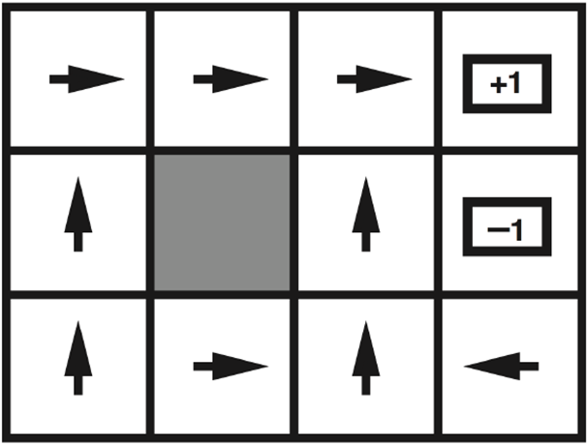
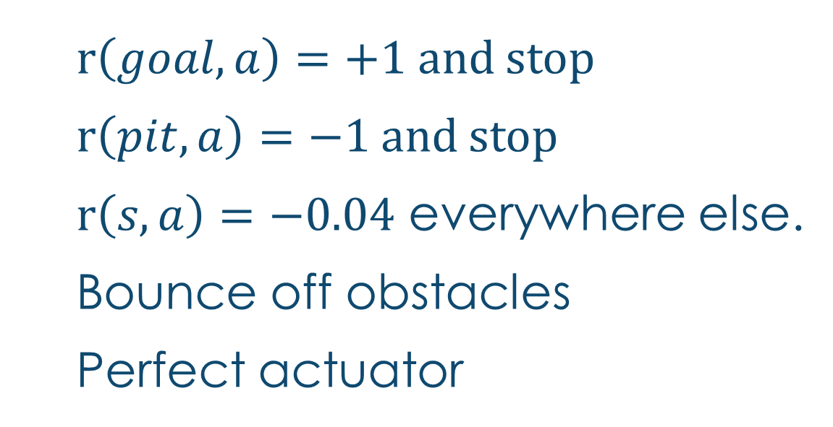
Optimal policy: perfect actuator
Goal
$r\left(goal,a\right)=+1$ and stop
$r\left(pit,a\right)=−1$ and stop
$r\left(s,a\right)=−0.04$ everywhere else.
Bounce off obstacles
Perfect actuator
Pit

Slide 36
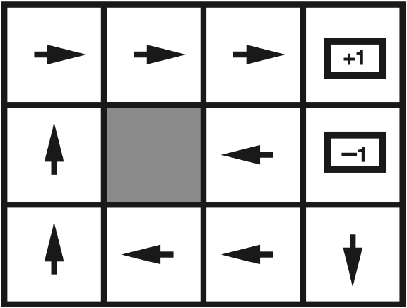

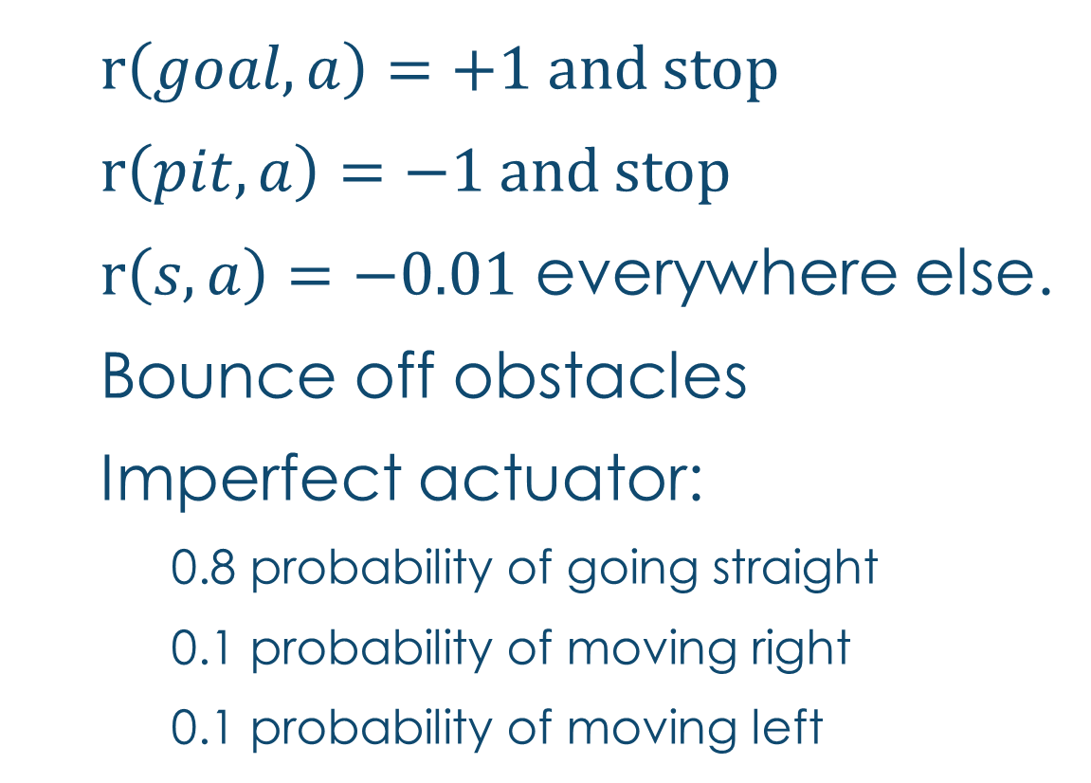



Optimal policy: Imperfect actuator
$r\left(goal,a\right)=+1$ and stop
$r\left(pit,a\right)=−1$ and stop
$r\left(s,a\right)=−0.01$ everywhere else.
Bounce off obstacles
Imperfect actuator:
0.8 probability of going straight
0.1 probability of moving right
0.1 probability of moving left
Goal
Pit

Slide 37
Optimal Policies
R(s) = -0.01
R(s) = -0.03
R(s) = -0.4
R(s) = -2.0
Notes:
R(s) = the “living reward”

Slide 38
Scope of MDP applicability
The Markov Decision Process is a general probabilistic framework and can be applied in many different scenarios.
Planning
Full access to the MDP, compute an optimal policy.
“How do I act in a known world?"
Policy Evaluation
Full access to the MDP, compute the `value' of a fixed policy.
“How will this plan perform under uncertainty?“
Reinforcement Learning
Limited MDP access: reward and transition models unknown.
“Can I learn to act in an uncertain world?"
<https://en.wikipedia.org/w/index.php?title=Markov_decision_process&oldid=855934986> [accessed 11 September 2018]

Slide 39
Looking Ahead
Bellman equations
Mathematical underpinning for MDP and RL algorithms
MDP algorithms
Planning and policy evaluation algorithms based on perfect knowledge of the states, actions, rewards
and transitions of the problem space.
Reinforcement learning algorithms:
Policy optimization algorithms with knowledge of the
states and actions but no knowledge of the rewards
and transitions of the problem space.

Slide 40
3 mdp algorithms
Assumes complete knowledge of the MDP.
Expectimax – a top-down recursive tree search algorithm similar to the minimax game search algorithm with a fixed search depth (finite horizon) that finds the optimal expected value of the current state.
Value Iteration – a bottom-up dynamic programming algorithm that finds the optimal expected value of every state. There are two variants: 1) finite horizon value iteration; and 2) infinite horizon value iteration.
Policy Iteration - a bottom-up dynamic programming algorithm that finds the optimal policy.

Slide 41
Reinforcement learning algorithms
Assumes incomplete knowledge of the MDP i.e., no knowledge of the reward or transition models.
Model-based reinforcement learning are based on the various MDP algorithms and try to build reward and transition models by exploring the environment.
Model-free reinforcement learning ignore the reward and transition models and try to learn the Q and/or V functions directly.

Slide 42
Model-based Reinforcement learning
Model-based reinforcement learning is based on the various MDP algorithms and typically involve alternating between the following steps:
Exploit the environment using the current reward and transition models.
Explore the environment to learn the reward and transition models.
Run an MDP algorithm to create new reward and transition models.

Slide 43
Model-free Reinforcement learning
Model-free reinforcement learning does not know and does not try to learn the reward and transition models. Instead it attempts to find an optimal policy π using other means. There are many such algorithms including:
Q-Learning
SARSA
Monti-Carlo
Approximate Q-Learning
Dyna-Q
Deep Q-Learning
…

Slide 44
Model-based vs model-free
Model-Based
Pros:
Makes maximal use of experience.
Solves model optimally given enough experience.
Cons:
Requires computationally expensive solution procedure.
Requires the model to be small enough to solve
Model-Free
Pros:
Solution procedure is relatively more efficient.
Can handle much larger models.
Cons:
Learns more slowly. Does not learn as much as a model-based RL in a single training episode. (“Leaves information on the table”).
Unable to make predictions about transitions in the environment.

Slide 45
Optimal Quantities
The value (utility) of a state s:
V*(s) = expected utility starting in s and acting optimally
The value (utility) of a q-state (s,a):
Q*(s,a) = expected utility starting out having taken action a from state s and (thereafter) acting optimally
The optimal policy:
π*(s) = optimal action from state s
s
s is a state
a
(s, a) is a q-state
s, a
s,a,s’
(s,a,s’) is a transition
s’
Credit: CS188 – Intro to AI, UC Berkeley, ai.berkely.edu
Notes:
Demo just shows V and Q values, snapshots on next slides.

Slide 46



The Bellman Equations
There is one equation $V^{∗}(s)$ for each state s.
There is one equation $Q^{∗}(s,a)$ for each state s and action a.
These equations define a relationship, which when satisfied guarantees that $V^{∗}(s)$ and $Q^{∗}\left(s,a\right)$ are optimal for each state and action.
This in turn guarantees that the policy $π^{∗}$is optimal.
s
a
s, a
s,a,s’
s’
Credit: CS188 – Intro to AI, UC Berkeley, ai.berkely.edu
Credit: CS181 – Machine Learning, D. Parkes, Harvard Univ, Spring 2017
Notes:
Let’s start by equations that characterize these quantities through mutual recursions. [step through this by writing on slide, one step at a time]
Recursive characterization of V* in terms of V*; not necessarily helpful; but it is a characterization.
Note: this is a set of equations that needs to be satisfied; but it could have multiple solutions (it does not, but at this stage of our knowledge it could).

